Slide 1
Welcome!
Developing a Volunteer Culture

Slide 2
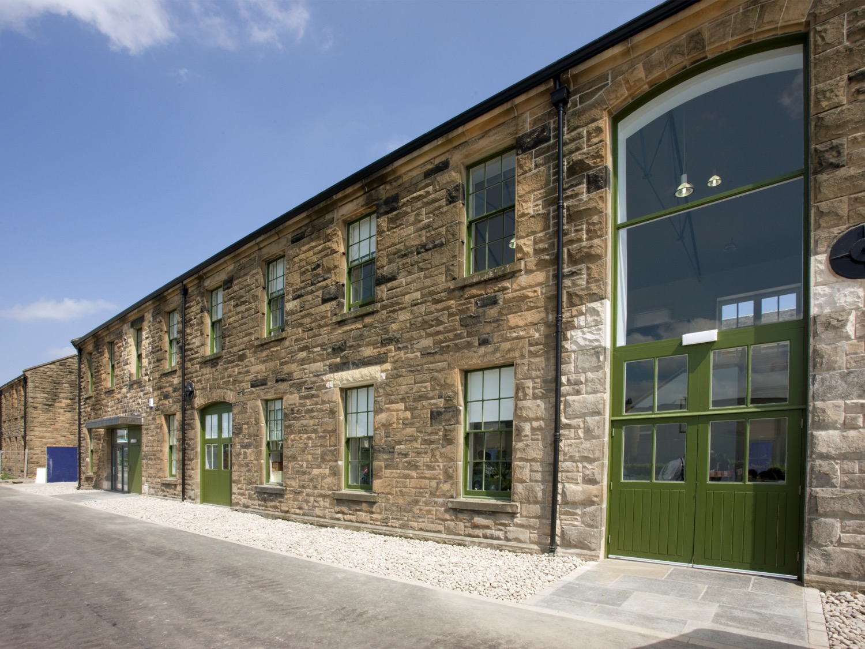
Volunteer Scotland
Disclosure Services

Slide 4
1. Policies
3.Diversity
4.Roles
5.Safety
8.Support
2.Resources
6.Recruitment
7.Induction
9.Recognition

Slide 5
The Scottish Government “Volunteering for All – Our National Framework”
The Scottish Government recognises that volunteering matters and its all about new experiences, feeling good and making a difference. The evidence base is clear on the benefits of volunteering, in terms of:
Physical Health Benefits – the evidence suggests that volunteering can promote healthy lifestyle and improve self-rated health;
Social Benefits – research finds that volunteering can improve companionship, tackle social isolation and increase social capital;
Mental Wellbeing – evidence shows that volunteering can improve confidence, purpose and life satisfaction; and,
Instrumental Benefits – volunteering can help people to develop new skills, gain knowledge, develop attitudes and increase employability.

Slide 6
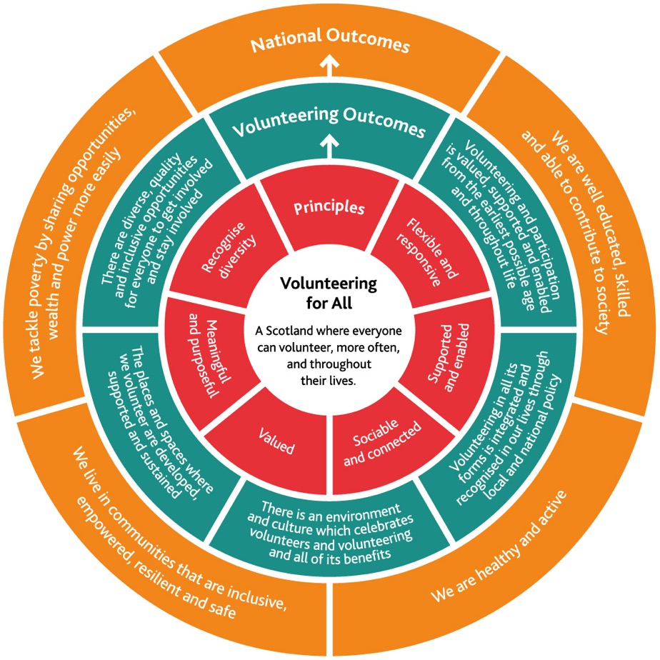
Our National Framework

Slide 7
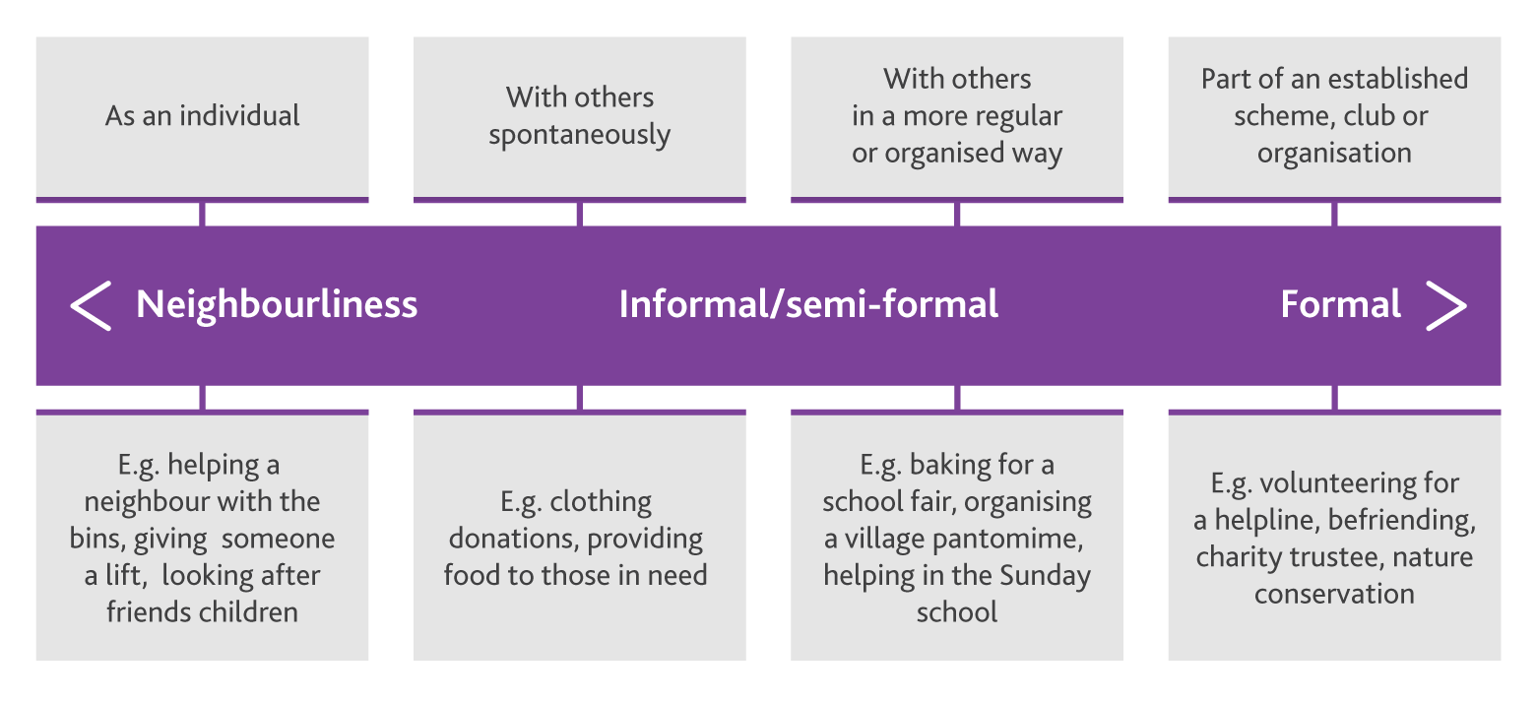
What is Volunteering?
The Scottish Government’s Volunteering for All – Our National Framework defines volunteering as a choice.
“A choice to give time or energy, a choice undertaken of one’s own free will and a choice not motivated for financial gain or for a wage or salary”

Slide 8
Session Objectives
Explain what is meant by organisational culture.
Recognise how aspects of culture might impact upon someone’s experience of volunteering.
Identify the practical steps to take to change organisational culture and develop a volunteer culture within your organisation.

Slide 9
Developing an Organisational Culture

Slide 10
Organisational Culture
Geert Hofstede

Slide 11
Organisational Culture
How can you identify an organisational culture?
What do you see?
What do you feel?
What do you hear?

Slide 12
Parts of an Organisational Culture
Symbols
Behaviours
Attitudes
Rituals
Beliefs

Slide 13
Your Experience of Organisational Culture
What organisations do you like?
Why do you like them?
How do you feel when you interact with them?

Slide 14
Characteristics of an Organisational Culture

Slide 15
Let’s have a chat…!

Slide 16
Developing a Volunteer Culture

Slide 17
What is a Volunteer Culture?

Slide 19
Supporting Volunteer Culture?
What can we introduce at each stage of our volunteer practice model to support a volunteer culture?
Thinking about volunteering
Getting started
Making a difference
Building on success

Slide 20
Let’s have a chat…!

Slide 21
Organisational Values and Volunteering

Slide 22
Organisational Values and Volunteering
What are organisational values? What do they tell us about the culture of an organisation?

Slide 23
Organisational Values and Volunteering
Examples of organisational values
Be open and honest Put our clients’ needs first
Commitment to excellence Promote wellbeing
Shared responsibility Equality of opportunity
Respect for others Trust and empower our people
Act with integrity Inspire people

Slide 24
Organisational Values and Volunteering
Examples of organisational values
Continuous improvement Take pride in our work
Leadership and change Innovation
Customer service Learning from others
Be accountable Aim for success, learn from failure

Slide 25
Organisational Values and Culture

Slide 26
Let’s have a chat…!

Slide 27
Organisational Values and Volunteering
Is your volunteer programme matching the organisational values and culture?
Does your organisation fully support your volunteer programme and volunteering?
Does your organisation fully understand what volunteering is?
How do you know?

Slide 28
Top Tips
Identify the symbols, behaviours, attitudes, rituals and beliefs that make up your organisational culture.
Consider the impact that the organisational culture has on the volunteering experience.
Make practical changes in all aspects of volunteer management to develop a volunteer culture.
Consider the values of your organisation. Will you need to identify new values for volunteering?
Think about the leadership of volunteering. What’s your role? Who do you need to influence or engage?

Slide 29
Session Objectives
Explain what is meant by organisational culture.
Recognise how aspects of culture might impact upon someone’s experience of volunteering.
Identify the practical steps to take to change organisational culture and develop a volunteer culture within your organisation.

Slide 30
Thanks and any questions?

